Slide 1

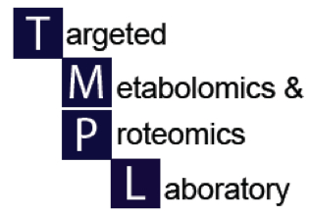

Nuclear Magnetic Resonance
the NMR Platform
N. Rama Krishna, Ph.D.

Slide 2
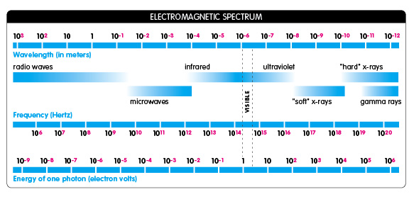
NMR Spectroscopy
Where is it in the spectrum?

Slide 3
NMR Metabolomics
Advantages
Quantitative estimate of concentration of metabolites
Highly Reproducible
Detects all metabolites simultaneously
Nondestructive. You can recover the sample completely (and use it for MS Metabolomics)
Minimal sample preparation and no need for derivatization
Disadvantages:
Sensitivity (micromolar to millimolar concentration range).
NMR spectra are complex (signals from different metabolites can overlap)

Slide 4
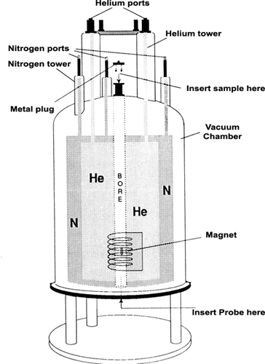
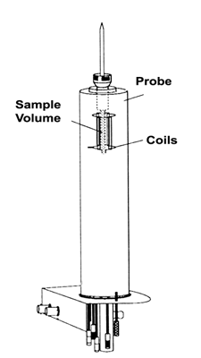
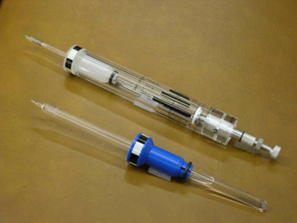
NMR Magnet and the probe
Sample is positioned on the probe using a spinner.
AVANCE Beginners User Guide 004 (Bruker, Germany)
Notes:
Left hand side shows the inside of the magnet dewar. The magnetic coil is covered with liquid helium (4 K). There is a outer jacket of liquid nitrogen to cool the system to minimize evaporation of liquid helium. The right hand side shows how the sample is positioned in the probe. The sample is inserted via a cushion of air.

Slide 5
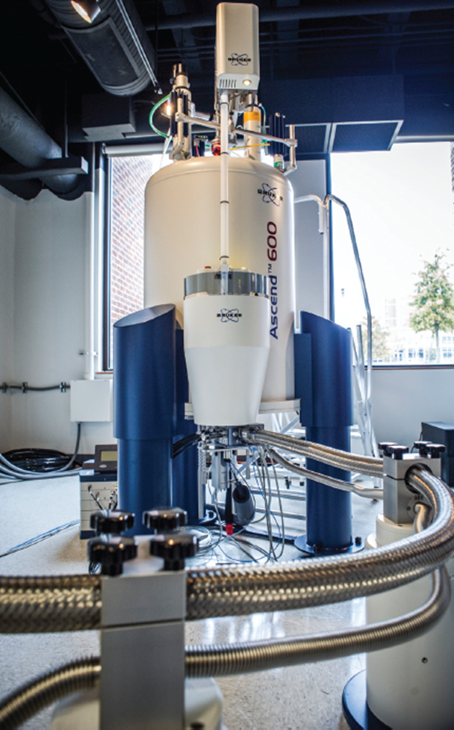
Bruker-Biospin Avance III HD
600 MHz NMR Spectrometer with
TCI-CryoProbe and Sample Case
Central Alabama High-Field NMR Facility
Bruker-Biospin Avance III 600 MHz NMR system with TCI CryoProbe and Sample Case

Slide 7
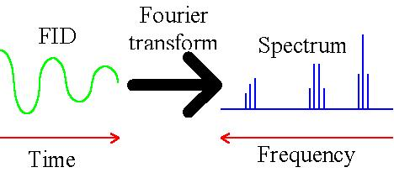
NMR Data Collection and Initial Processing
A π/2 rf pulse is applied to cause transitions. The resulting signal (called FID (free induction decay)) is then Fourier transformed to frequency domain to obtain the NMR spectrum for each different nuclei.
π/2
_________________
Time (sec)
frequency (Hz)

Slide 8
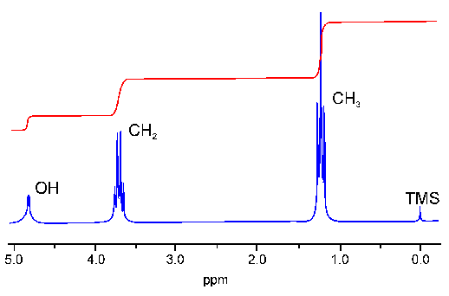
HO-CH₂-CH₃
low
field
high
field
ω_{o}
Notice that the intensity of peak is proportional to the number of H atoms.
Note: We will discuss the fine structure in each peak in a later slide.

Slide 9
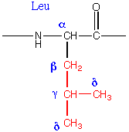
There are through-bond ¹H-¹H couplings that are finite over 2 and 3 bonds, and vanish rapidly after that. They cause multiplet structure.
These are the basis of the COSY and TOCSY experiments.

Slide 10
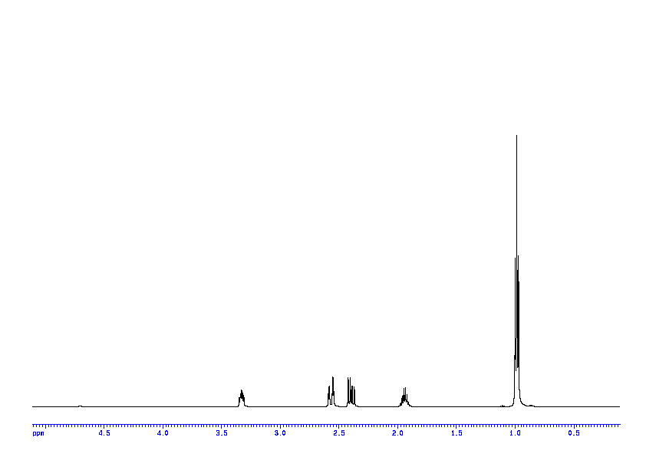
α β β’ γ δ
¹H 1D-NMR spectrum of Leucine/D₂O, showing splittings from J-couplings

Slide 11
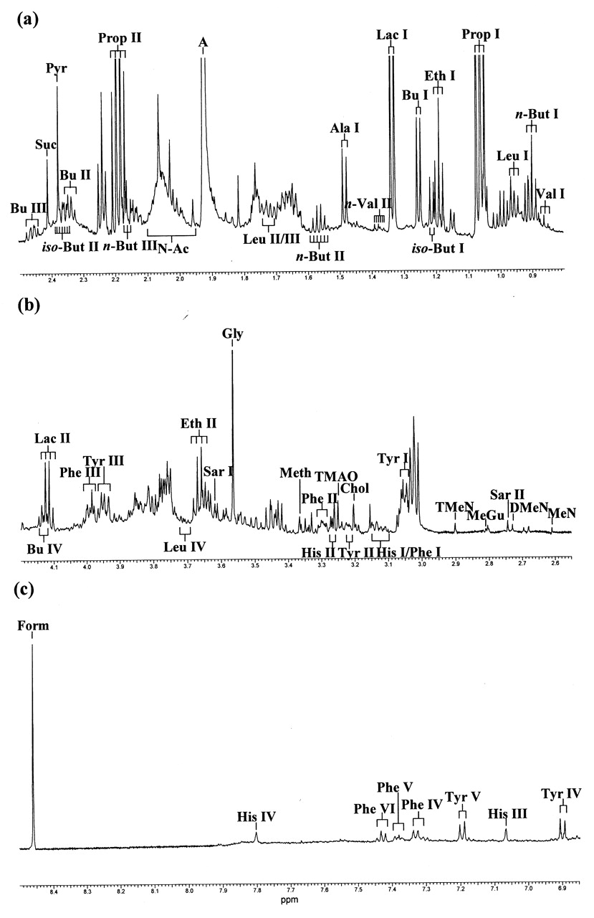

Figure 1. Single-pulse 1D ¹H NMR spectrum of a human salivary supernatant specimen.
Silwood C et al. J DENT RES 2002;81:422-427
Copyright © by International & American Associations for Dental Research
Notes:
Single-pulse 1D 1H NMR spectrum of a human salivary supernatant specimen. (a-c) Expanded 0.80-2.50, 2.55-4.20, and 6.85-8.50 ppm regions, respectively, of the 600.13-MHz single-pulse 1H NMR spectrum of a human salivary supernatant specimen (pH value 6.78). A typical spectrum is shown. Abbreviations: A, acetate-CH3; Ala I, alanine-CH3; Bu I, β-hydroxybutyrate γ-CH3 group protons; Bu II, III, and IV, β-hydroxybutyrate β, β′, and α protons, respectively (ABX coupling system); iso-But I and II, iso-butyrate-CH3 and -CH group protons, respectively; n-But I, II, and III, n-butyrate γ, β, and α protons, respectively; Chol, choline-N+(CH3)3; DMeN, dimethylamine-CH3; Eth I and II, ethanol-CH3 and -CH2 group protons, respectively; Form, formate-H; Gly, glycine-CH2; His I and II, histidine ABX β protons; His III and IV, histidine imidazole ring protons; Lac I and II, lactate-CH3 and -CH protons, respectively; Leu I, II, III, and IV, leucine δ, γ, β, and α protons, respectively; MeGu, methylguanidine-CH3; MeN, methylamine-CH3; Meth, methanol-CH3; N-Ac, spectral region for acetamido methyl groups of N-acetyl sugars; Phe I and II, phenylalanine ABX β protons; Phe III, phenylalanine ABX α proton; Phe IV, V, and VI, phenylalanine aromatic ring protons; Prop I and II, propionate-CH3 and -CH2 group protons, respectively; Pyr, pyruvate-CH3; Sar I and II, sarcosine-CH3 and -CH2 group protons, respectively; Suc, succinate-CH2; TMAO, trimethylamine oxide ON(CH3)3; TMeN, trimethylamine-CH3; Tyr I and II, tyrosine ABX β protons; Tyr III, tyrosine ABX α proton; Tyr IV and V, tyrosine aromatic ring protons; and Val I and II, n-valerate δ and γ protons, respectively. Assignments of 1H NMR resonances to methylguanidine, sarcosine, n-valerate, and N-acetylsugars are tentative in this instance.

Slide 12
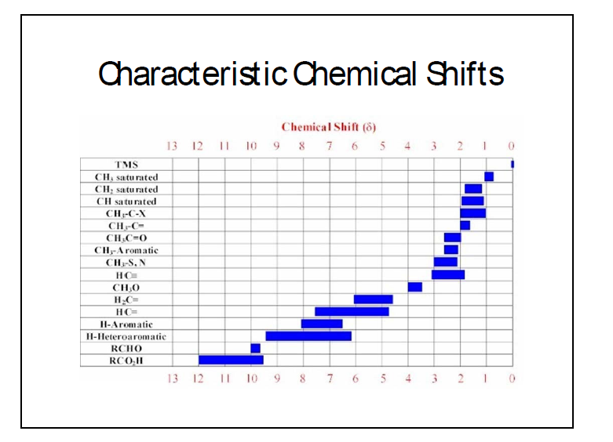
Characteristic Chemical Shifts

Slide 13
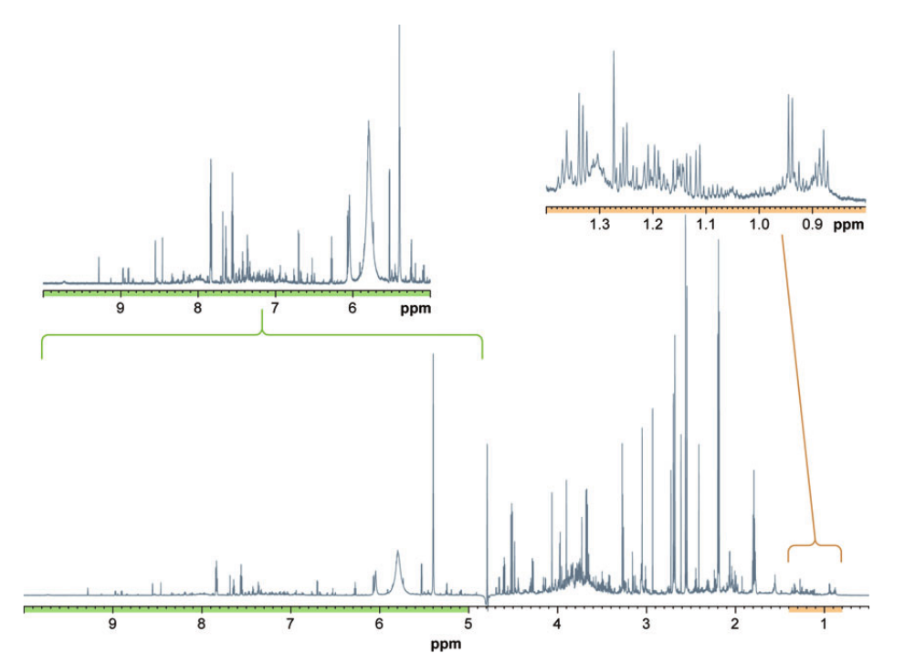
¹H NMR spectra of biofluids and cell extracts can be incredibly complex!
950 MHz NMR spectrum of urine

Slide 14
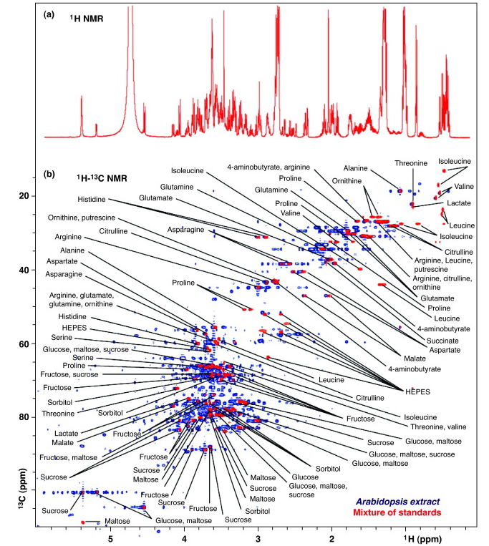
Metabolic Profiling Methods
Main Analytical Techniques
Nuclear Magnetic Resonance (NMR) Spectroscopy
HSQC used to select for protons directly bonded to ¹³C.
Use of HSQC spectroscopy for analysis of common metabolites. In 1D spectra, overlapped signals hamper identification of individual metabolites, whereas in 2D correlation, spots are easily visible.
(a) 1D ¹H NMR spectrum of an equimolar mixture of the 26 standards.
(b) 2D ¹H–¹³C HSQC NMR spectra of the same synthetic mixture (red) overlaid onto a spectrum of aqueous whole-plant extract from Arabidopsis (blue).
PMID: 21435731

Slide 15
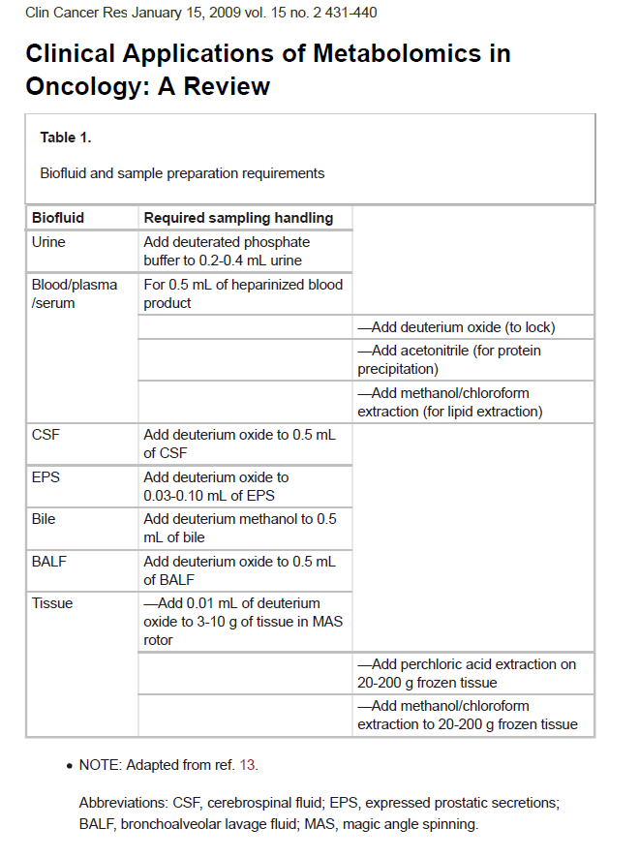

Note:
(a) It is typical to add some deuterated solvent (e.g., 5% D₂O) to the solution for Field-frequency lock, to compensate for the slow field drift of the magnet. Often, extracts of tissues (e.g., PCA extracts) are dissolved in D₂O to record CH proton NMR Signals.
(b) Since some metabolites have pH-sensitive chemical shifts, it is critical to record all NMR spectra at same pH (e.g., pH 7).

Slide 16
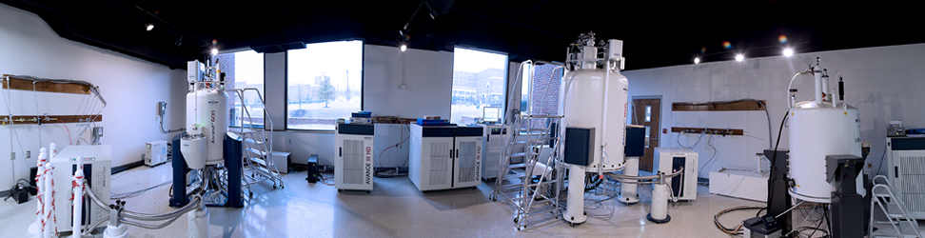
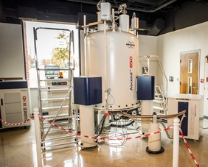
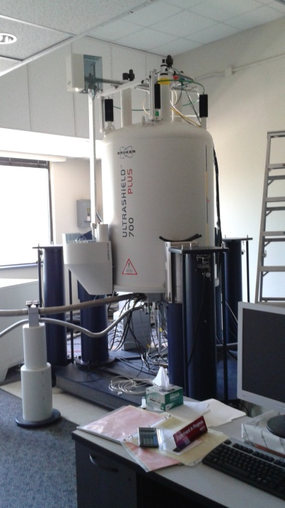
AV III HD 600
AV III HD 850
AV III HD 500
Central Alabama
High-Field NMR Facility
UAB
Contact: Dr. Ronald Shin
Ext: 4-5696
E-mail: shinr@uab.edu
AV III HD 850
AV II 700

